Slide 1
Navigating the Skies of Open AI: Perfect Your Grounding for a Smooth Landing
Brynn Borton

Slide 2




A Little Bit About Me
Avanade UK&I Data Platform Director (for the next 2 weeks)
Launching my own business in April
20 years and counting in Data & AI
Microsoft and Databricks Fan
Techie at heart
Can bore you senseless talking about Data Platforms and Microsoft Fabric
Currently obsessed with Open AI and LLMs
Done a bit of this sort of stuff before
https://www.linkedin.com/in/brynnborton
https://medium.com/@brynnborton
Please Give Me Feedback

Slide 3
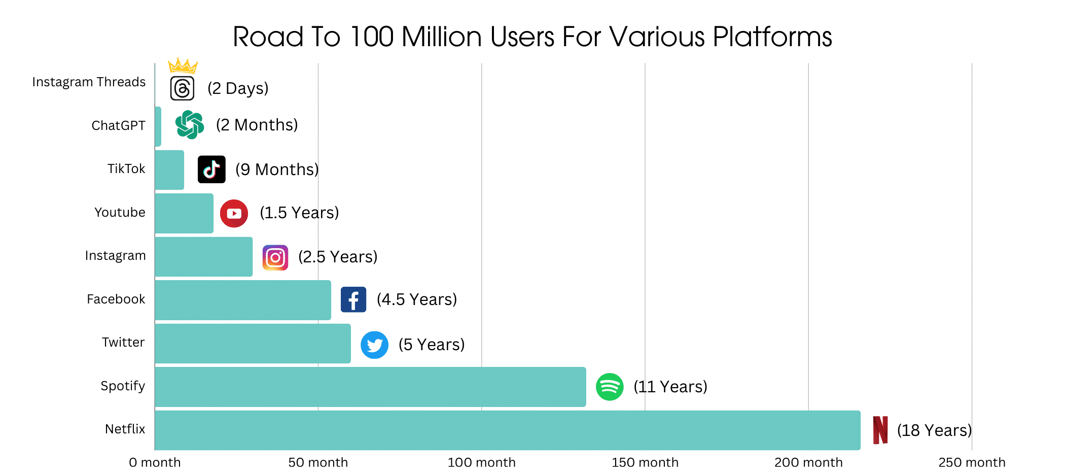
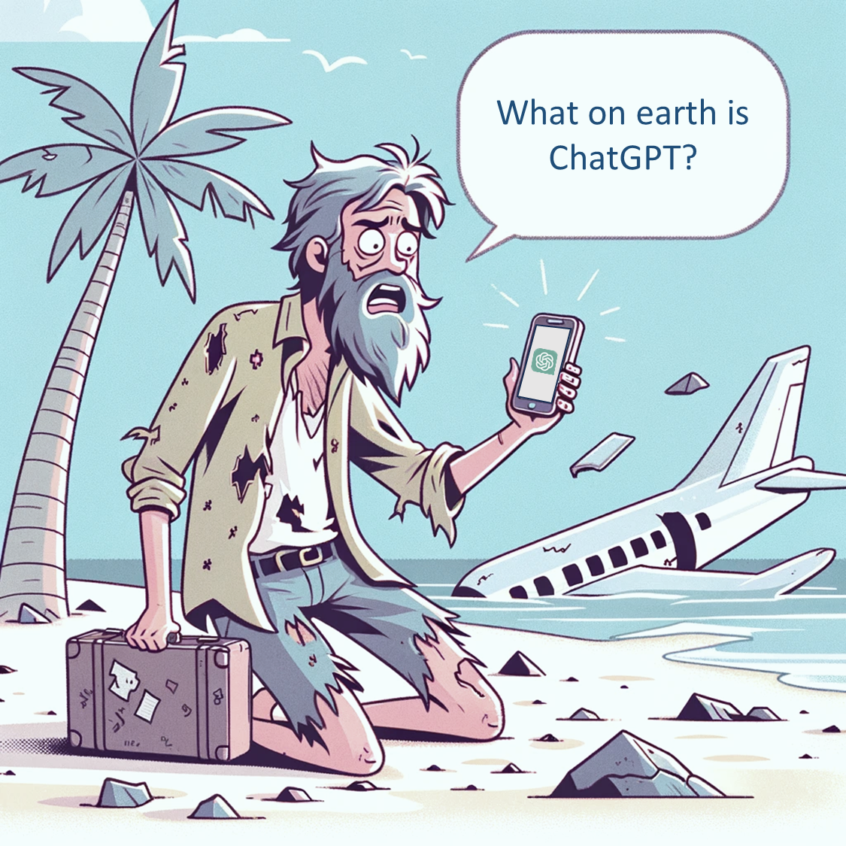

demandsage.com
180 Million
Active Users
explodingtopics.com
1.7 Billion
Visits per month
demandsage.com
$1.3B
Revenue 2023
Sacra.com
Valued at $80B
Reuters Feb 24
>92%
Fortune 500 Companies use ChatGPT
demandsage.com
$700,000
Daily Running Cost
demandsage.com

Slide 4



How does Chat GTP Work ? Large Language Models
GTP 3.5 Neural Network
Training Content
Neural Network
500 Billion Tokens
GTP4 ?
Trained on 13T
Tokens
Web Crawled
Text:
SQL
Bits
is
Great
.
Chat GPT Model
175B Parameters
Tokens:
[3666,4004,3124,318,13]
1.7T
Parameters
Mixture Of Experts (MoE) Model
Refined
Content
Input Layer
Input Layer 1
Input Layer …
Output Layer
96 layers
PPO
Proximal Policy Optimisation
RLHF
Reinforcement learning from human feedback

Slide 5

It knows everything on the internet up to its last training date (latest GTP4 version is 24th Jan 2024)
It cannot think for itself, it needs detailed instruction
It will forget everything instantly after answering
It DOES NOT know anything about recent news or events
It DOES NOT know anything about your internal company information.
If it doesn’t know something it will potentially make it up.
I know everything up to Jan 2024

Slide 6

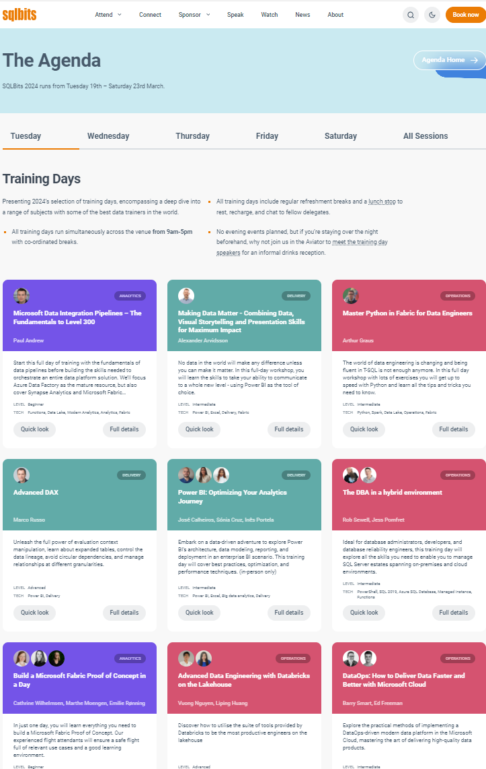
How do we get round the limitations?
Needs Instruction
Forgets Instantly
No Recent or Internal Knowledge
ChatGPT
Context
SQLBits
Enthusiastic Salesman
15-word output
User: Why is SQLBits so great?
GPT: it’s the ultimate…
System Prompt
You are an over enthusiastic salesman for SQLBits
Store
Output Prompt
Provide short answers 15 words or less
Prompt
Why is SQL Bits so great?
It's the ultimate SQL fiesta, where data dreams and tech magic come alive! Join us!
SQLBits is widely regarded as one of the most significant and influential SQL Server conferences in Europe, particularly cherished by the data and AI community for several compelling reasons:
Expert-Led Sessions: SQLBits provides an extensive range of sessions led by some of the world's top experts in SQL Server and related techno…..
Feed
Grounding Prompt
What is scheduled for the first day ?
Retriever
Could you please clarify what event or schedule you are referring to for the first day?
Kickstart with immersive training days—your golden ticket to SQL mastery and innovation!
As an AI developed by OpenAI, I don't have real-time access to current events.
Feed

Slide 7
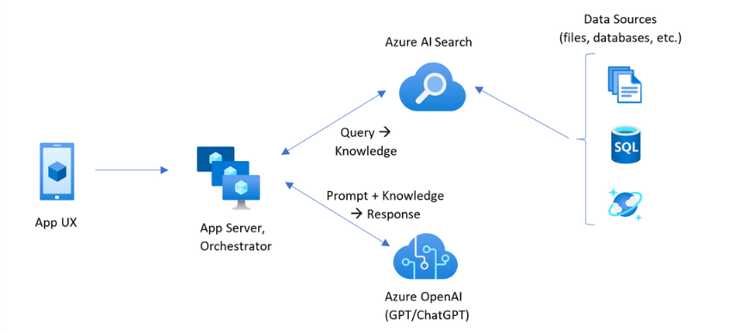
Retrieval Augmented Generation (RAG)

Slide 8
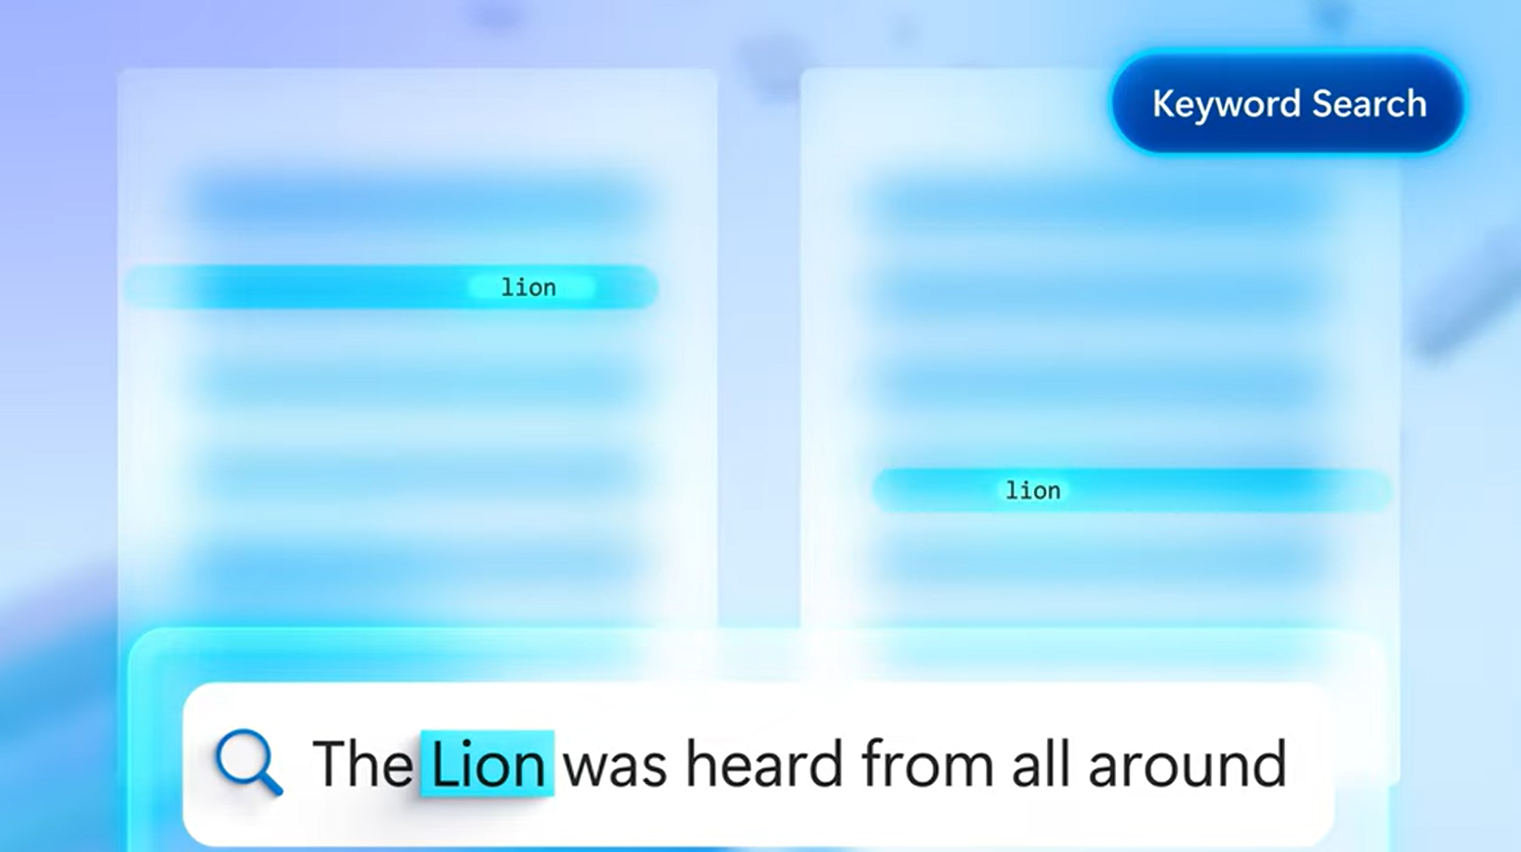
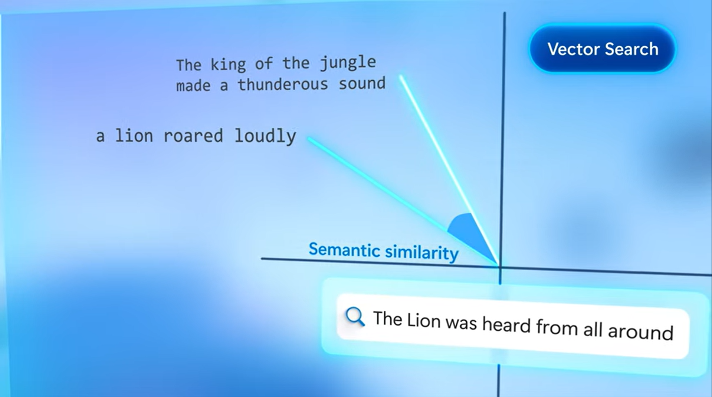
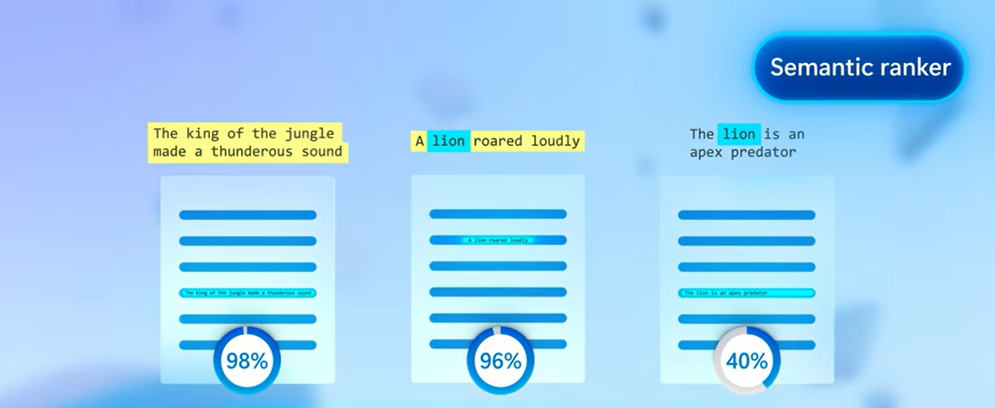
Azure AI Search
Keyword Search
Vector Search
Hybrid Search
+
Source: Hybrid search - Azure AI Search | Microsoft Learn

Slide 9














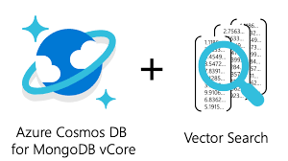

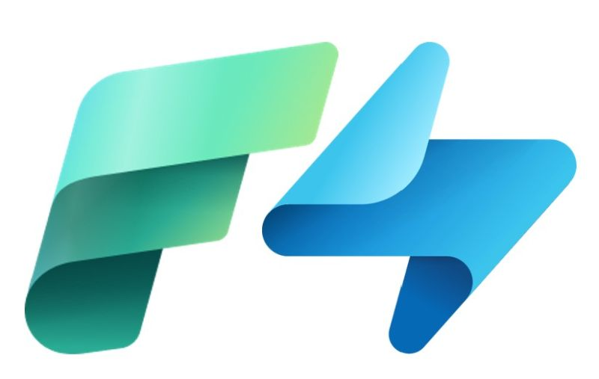





Alternate Vector Databases
Dedicated Vector Databases
Databases with Added Vector Support
Open Source
Fabric
Real-Time Analytics
Source Shareable / Commercial

Slide 10






How do Vector Embeddings Work ?
Embeddings are numerical representations of real-world objects and concepts, expressed as a vector
Embedding
Transformer Model
Vector Representations
Vector Representation
Approximate Nearest Neighbour
Embedding
Transformer Model
[ 1232, 5721, …, 3454 ]
text-embedding-ada-002
[ 1231, 3234, …, 3454 ]
[631, 0957, …, 7395]
[9573, 672, …, 9782]
[283, 432, …, 6790]
App/UX
text-embedding-3-large
text-embedding-3-small
Results

Slide 11
What if we have large documents?
Vector Representation
text-embedding-ada-002
[ 1232, 5721, …, 3454 ]
1000 pages
1000 Vectors
Vector DB
Chunking
…
text-embedding-ada-002
[ 1232, 5721, …, 3454 ]
….
1000 page
document
1000 chunks

Slide 12



















Chunking/Retrieval Techniques
Keep semantically related chunks of text together. Balance size vs context based on the use case.
Simple Character Splitting
SQLBits, the premier conference for all data professionals, is gearing up for its 2024 event with a theme that will soar to new heights—Aviation! In this behind-the-scenes look, we’ll explore the meticulous process of crafting a successful conference theme and delve into why aviation is set to take center stage at the Farnborough Conference and Exhibition Centre on March 19-23, 2024.
The art of crafting a conference theme:
Choosing a theme for a conference is no small feat. It’s not just about selecting a catchy phrase or topic—it’s about creating an immersive experience that resonates with attendees, speakers, and sponsors alike. The theme serves as the backbone of the entire event, guiding everything from the keynote speeches to the decor.
For SQLBits 2024, the committee went through an extensive brainstorming process to identify a theme that would captivate and engage the diverse community of the data platform while keeping on brand to our host venue. Aviation emerged as the clear winner, symbolizing precision, innovation, and the constant pursuit of excellence—qualities that mirror the spirit of our community.
Why Aviation?
Aviation is more than just airplanes; it represents the intersection of technology, engineering, and human achievement. Just as SQLBits attendees navigate the complexities of databases and technology, aviators navigate the skies using cutting-edge systems and expertise. You can see where we’re going with this, right? There are lots of cross-overs.
The Farnborough Connection:
Choosing the right venue is crucial for aligning the theme with the overall conference experience. Farnborough, home to the historic Farnborough International Airshow, provides the perfect backdrop for our aviation-themed SQLBits 2024.
The Farnborough Conference and Exhibition Centre boasts state-of-the-art facilities, making it an ideal space for data professionals to come together, learn, and network. Attendees can expect a conference experience that seamlessly integrates the world of tech with the awe-inspiring realm of aviation. Did you know that Farnborough is the UK’s first airfield in aviation history and home to the country’s first powered flight?
More Advanced Techniques
Code Text Splitter
Contextual Headers
HTML Text Splitter
Parent Document Retrieval
Markdown Text Splitter
Summary Embeddings
Custom Text Splitter
Hypothetical Queries
Token Text Splitter
Contextual Compression
Document Loaders
Multi-Query Retrieval
Semantic Text Splitter
Time Weighted Retrieval

Slide 13
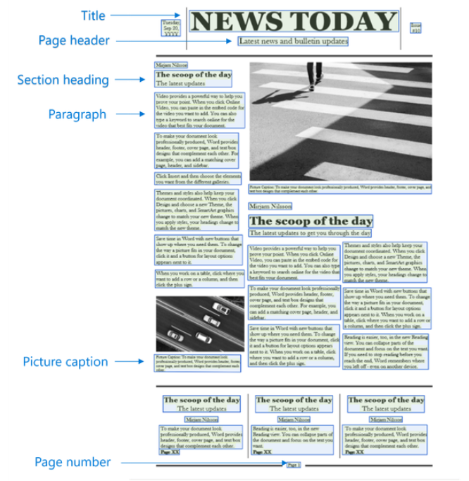


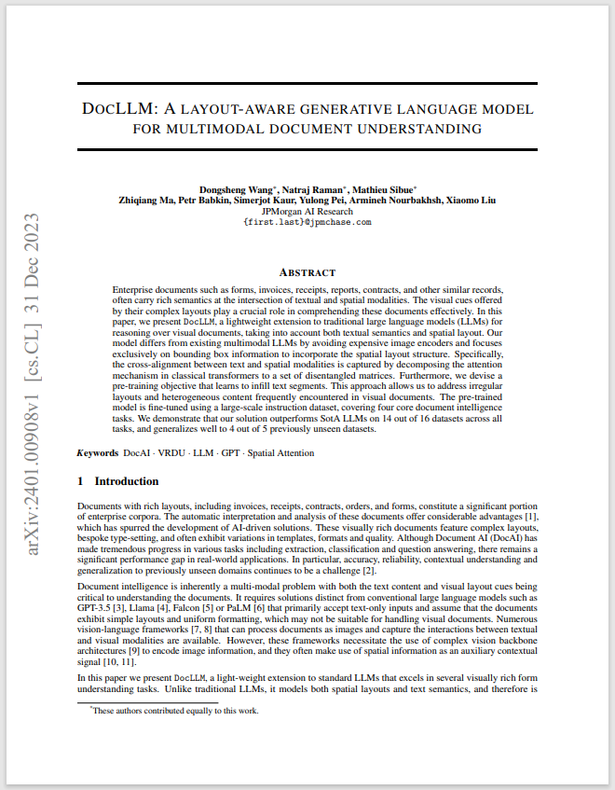
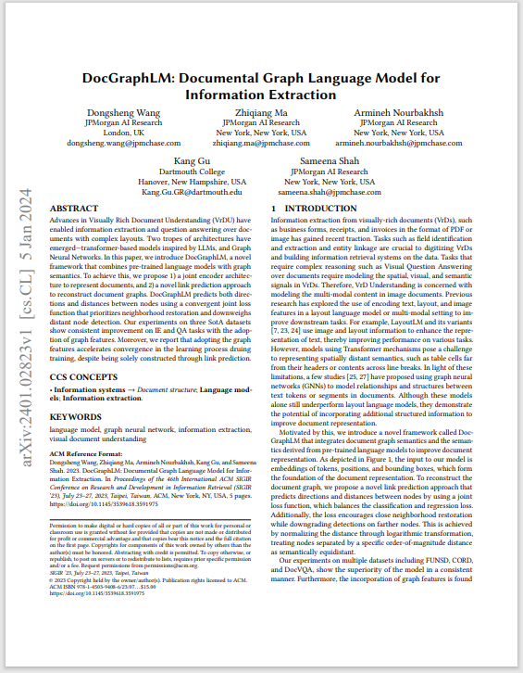
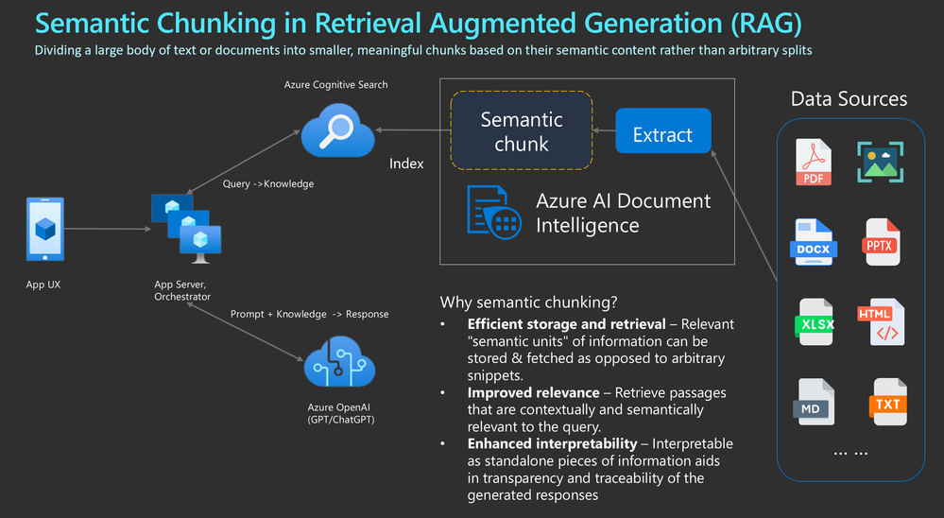
Structure-Aware AI Powered Document Processing
Doc LLM
DocGraph LLM
Azure AI Document Intelligence

Slide 14

Cost Implications
You pay for Tokens – Approximately equivalent to a word.
3 types
Input Tokens
Output Tokens
Embedding Tokens
Bigger models are more expensive, but they are getting cheaper. (prices per 1000 tokens)
GTP4 32K – Input 4.8p / Output 9.5p
GTP4 Turbo – Input 0.8p / Output 2.4p
Using smaller models can save you a lot
GTP3.5 Microsoft Turbo – Input 0.04p / Output 0.012p
Consider Small Language Models for Edge or high transaction apps.
Phi-2 – Microsoft
Gemini Nano – Google
Mistral – Open Source
Plan embeddings as they are costly to redo

Slide 15

Thankyou
Please spare 5 mins to give me feedback
You may even win a prize !

